Slide 1


Athena Cyber LLM
Glaukopis
Foundational Cyber Threat Intelligence Language Model for the next generation SOC: Athena-CTI-LLM-V1.0
© 2025 Athena Software Group Inc. Confidential & Proprietary. Do not distribute without express permission.
By Peter J Worth Jr
President & CEO, Athena Software Group Inc.

Slide 2

01
Athena Software Group
02
Cyber LLM Market Overview
Athena’s CTI-LLM Design (Glaukopis)
03
LLM Finetuning & Optimization
04
Threat Intel Data Integration (Ignite et al)
05
Product Development Lifecycle
06
Summary

Slide 3
Athena Software Group
Who we are and why we are different

Slide 4
Athena Software Group Inc.
A company founded under the principles of integrating Cyber Security best practices, high end custom enterprise software and artificial intelligence (LLMs).
Athena Software Group brings together some of the best minds in computer science, cyber defense and SaaS to design solutions specifically for application service providers.
We take a fully integrated and analytical approach to Cyber Security defense, knowing through experience that the best Cyber Defense strategies arise from providing the best analysts with the best tools from within a fully integrated cyber security infrastructure that is informed by the latest cyber and t
We intend to set a new bar in Cyber defense by providing tools along the entire Cyber defense stack which are fully integrated with Cyber specific trained LLMs that both understand the global threat landscape AND are informed by the technical specifications which underpin the application specific infrastructure environment facilitating higher quality, more rapid and informed outcomes with respect to threat and anomaly detection, response management, vulnerability management and compliance.

Slide 5
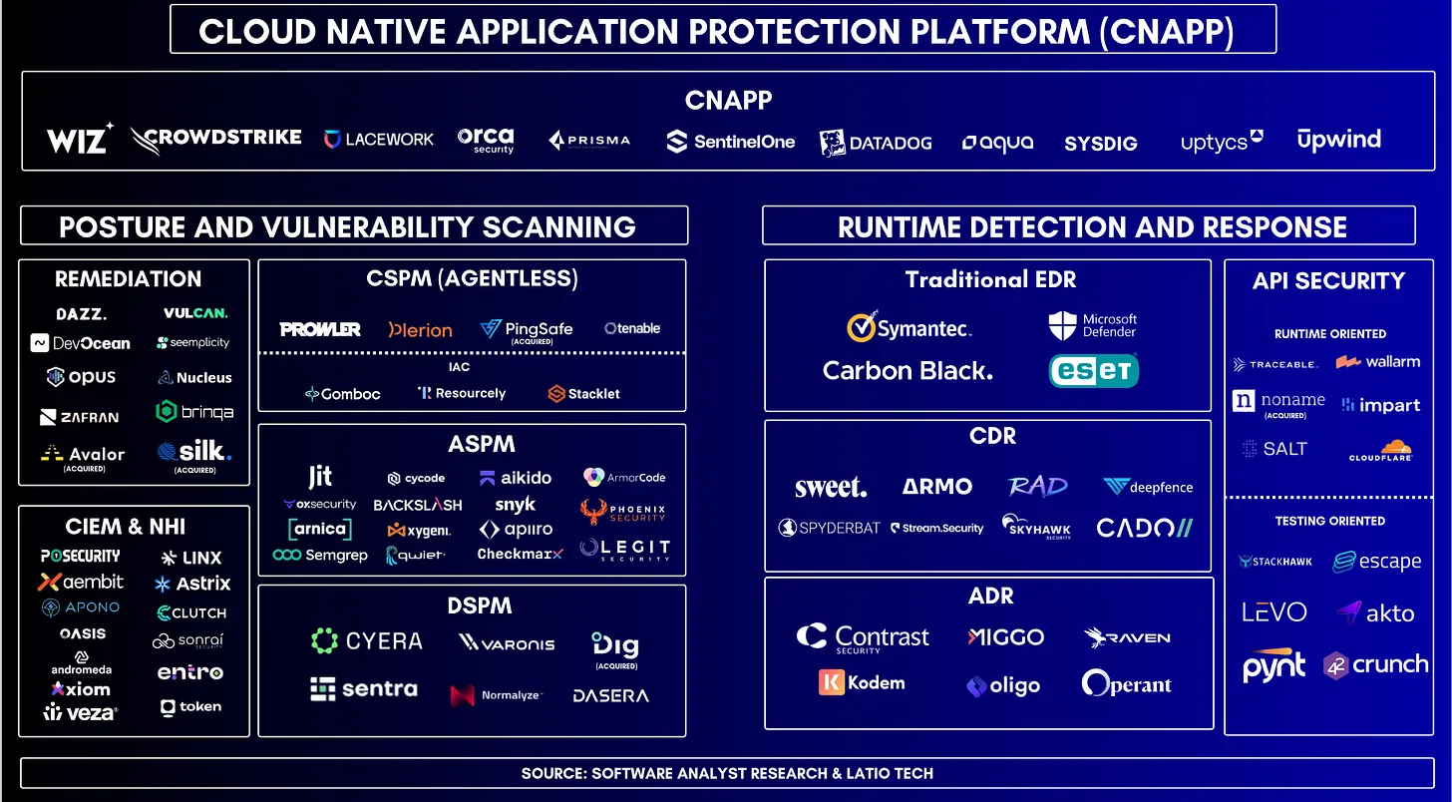
Cloud Solution Providers
Cloud Solution Providers
If you’re not overwhelmed and confused, you’re not paying attention
If you’re not overwhelmed and confused, you’re not paying attention

Slide 6



The Cybersecurity Challenge
Proliferation of security tools
Siloed data and lack of integration
Overwhelmed security teams
Organizations employ a variety of security tools, such as firewalls, web application firewalls (WAFs), intrusion detection systems (IDS), and endpoint detection and response (EDR) solutions, leading to a complex and fragmented security landscape.
Security data is often trapped in individual tools, making it difficult to gain a comprehensive view of the threat landscape and hindering effective threat detection and response.
Security teams struggle to correlate and analyze data from multiple disparate tools, leading to increased workloads and delays in identifying and addressing security incidents.
The fragmentation of security tools and siloed data across an organization's network infrastructure hinders the ability to detect, analyze, and respond to threats in a timely and effective manner, presenting a significant challenge in today's evolving cybersecurity landscape.

Slide 7
The Value of an Integrated Approach
Enhanced Threat Detection
Improved Threat Analysis
Streamlined Remediation
Consolidating security tools and data across the network allows for a more comprehensive view of potential threats, enabling faster and more accurate detection of anomalies and suspicious activities.
By integrating data from various security components, security teams can analyze threat patterns and indicators more effectively, leading to better informed decision-making and more efficient incident response.
An integrated approach facilitates the coordination of remediation efforts, allowing security teams to respond to threats quickly and consistently across the entire network infrastructure.
Reduced Operational Overhead
Enhanced Visibility and Reporting
Consolidating security tools and data eliminates the need for manual correlation and analysis across disparate systems, reducing the time and resources required for security operations.
Integrated security solutions provide a holistic view of the organization's security posture, enabling more comprehensive and meaningful reporting to stakeholders and decision-makers.

Slide 8
Key Components of Athena’s Fully-Integrated Cyber Defense Solution
Web Application Firewall (WAF)
  Protects web applications from common web-based attacks by inspecting and filtering incoming traffic, enforcing security policies, and detecting and mitigating threats such as SQL injection, cross-site scripting, and application-level DDoS attacks.
Firewall
  Provides a perimeter defense by controlling and monitoring the incoming and outgoing network traffic based on predetermined security rules, protecting the network from unauthorized access and preventing the spread of malware and other threats.
Network Intrusion Detection System (NIDS)
  Monitors network traffic for signs of malicious activity, such as unauthorized access attempts, network-based attacks, and suspicious data patterns, and alerts security teams to potential threats in real-time.
Endpoint Detection and Response (EDR)
  Continuously monitors and analyzes activity on individual endpoints (e.g., laptops, desktops, servers) to detect, investigate, and respond to advanced threats, including malware, zero-day attacks, and suspicious user behavior.
Security Information and Event Management (SIEM)
  Collects, analyzes, and correlates security-related data from various sources across the network, providing a centralized view of the organization's security posture and enabling faster detection, investigation, and response to security incidents.

Slide 9
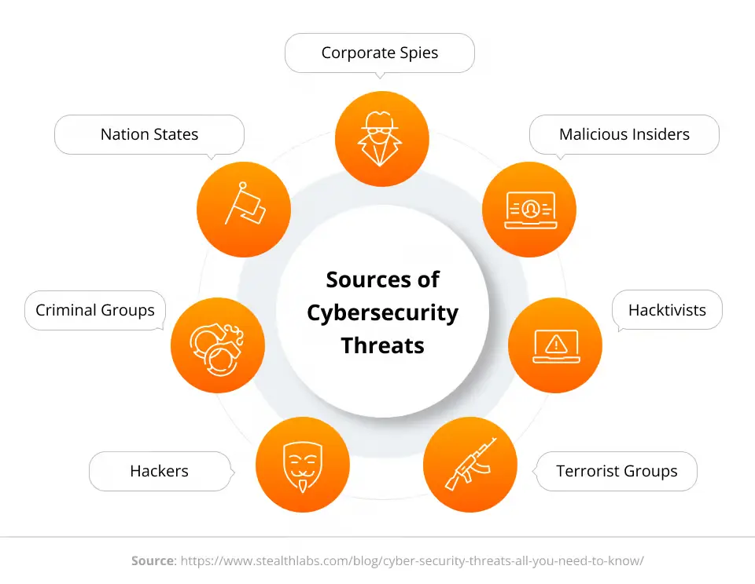
Maximizing Cybersecurity with an Integrated Defense Strategy
By adopting an integrated cyber defense strategy that consolidates security tools and data across the network, organizations can significantly improve their ability to detect, analyze, and respond to threats in a timely and effective manner. This approach not only enhances overall cybersecurity posture but also empowers security teams to make more informed decisions and optimize their resources.

Slide 10
Athena the Product Suite
Athena
Network Intrusion Detection & Response (NIDR)
WAF & Firewall
System Incident Monitoring & Remediation (SIEM)
Vulnerability Management & Response
Application Performance Monitoring
Dashboard & Analytics
Global Threat Intelligence
Security Language Model
Legal & Compliance
Athena Software Group was founded with the vision that it should not be complicated to setup and maintain a best in class Cyber security posture for an enterprise application. The idea originates from the experience of one of the founders in building and supporting large scale, secure SaaS application infrastructures that house protected data for over two decades.
Most security software solutions are targeted at the entire corporate network infrastructure and as such CISO’s and Security Operations professionals who are responsible for maintaining the security posture of ASPs are left with the task of cobbling together a variety of tools across the observability, telemetry, IDS, SIEM, WAF and performance monitoring landscape to gain full visibility into their environment and detect and prevent threats.
This problem is further exacerbated with the deluge of information in the form of reports, email alerts and SIEM data that comes from these disparate providers, creating a complex and noisy monitoring and alerting environment where the discernment of critical information itself becomes a challenge, affecting incident response times which is the most critical metric in determining the extent and scope, and ultimately cost, of a data breach.

Slide 11


Glaukopis (γλαυκῶπις) the “grey eyed one”

Slide 12
Our Services
Core Cyber Security Tools (Promachos)
Threat Intelligence Model (Glaukopis)
Cyber Product Development & Operations Support
Subscription fees, sized according to application complexity & scale
Custom Threat Intelligence LLM, license model channel dependent
Outsourced cyber security related product and/or operational support. Priced per project.

Slide 13
Product Roadmap & Go to Market Timeline
2025
2026
2027
2028
ALPHA
BETA
GAMMA
Delta
Entity & Team Build.
Site setup and Branding
Proof of Concept
Go to Market Strategy
Funding
Beta Release
Production Operations
Design Partners & Solution Delivery
Product Refinement & optimization
GA
SOC Operations & outsourcing
Partner Channels
Sales & Marketing Scale Additional Funding, Valuation
Market Disruption
Generation II LLM
Larger Customer Deployments
Custom Engagements
Release Early & Often
Engage Design Partners Early for market fit and revenue alignment
Raise funds only as necessary
Notes:
https://pixabay.com/en/entrepreneur-startup-start-up-man-593377/

Slide 14
Cyber Threat Intel Trained LLMs (CTI-LLM)
Use Case Model, Domain Overview

Slide 15
Foundational Use Cases for Cyber Security Language Models
1. Threat Detection and Anomaly Identification
LLMs can analyze extensive logs, network events, and telemetry data, recognizing subtle patterns indicative of cyber threats or anomalies. They provide contextual understanding of suspicious activity, correlating seemingly unrelated events to identify potential breaches or attacks.
2. Security Incident Response Automation
Automating responses to standard security incidents by interpreting alerts, analyzing context, and suggesting or executing initial remediation steps. Streamlining the triage process to quickly prioritize critical threats based on context derived from past incidents.
3. Vulnerability Assessment and Management
Parsing security bulletins, advisories, and CVE databases to summarize and highlight critical vulnerabilities relevant to an organization's infrastructure. Generating actionable mitigation strategies and prioritization recommendations tailored to the organization's specific technologies and risk profile.
4. Phishing and Social Engineering Detection
Identifying suspicious patterns in emails, text messages, and other communication platforms by leveraging natural language understanding to detect phishing, impersonation, or manipulative techniques. Educating users by generating realistic phishing simulations or context-aware cybersecurity training content.
5. Cybersecurity Documentation and Compliance Automation
Generating compliance reports, incident documentation, and audit logs automatically, reducing the manual burden associated with regulatory requirements (e.g., GDPR, NYSDFS 23 NYCRR 500).Assisting in the interpretation of regulatory texts, summarizing complex cybersecurity requirements, and suggesting compliance actions.
6. Intelligent Threat Intelligence
Parsing vast amounts of threat intelligence data to provide concise, actionable insights tailored to an organization's unique threat landscape. Automatically generating intelligence reports or briefings about emerging threats and their implications for the organization.
7. Cybersecurity Assistant (Chatbot/Virtual Analyst)
Serving as a first-line assistant that provides cybersecurity support, answering questions about policies, procedures, recent threats, or incident response guidelines. Assisting cybersecurity analysts by summarizing logs, incidents, or threat intelligence data to expedite informed decision-making.
8. Code and Software Security Analysis
Reviewing code repositories, documentation, and logs to identify potential security weaknesses, such as insecure coding patterns, hardcoded credentials, or risky configuration settings. Suggesting secure coding practices and generating contextual remediation steps.
9. Enhanced SIEM and Log Analysis
Integrating LLMs with Security Information and Event Management (SIEM) platforms to provide enhanced semantic understanding of security logs, correlate events, and reduce false positives through natural language analysis. Improving root-cause analysis by interpreting event logs and contextualizing security events.
10. Retrieval-Augmented Generation (RAG) for Security
Employing RAG models to access up-to-date cybersecurity knowledge bases or internal documentation, providing timely, accurate, and contextually relevant answers during security incidents or routine operations.
Threat intelligence application is the target for first phase, with incident response, compliance automation, analysts support and RAG integration (1, 2, 5, 7 and 10) as potential targets thereafter. Models must be trained on Cyber security data (public + private) and then plugged into the environment for proper contextualization and customization of output

Slide 16
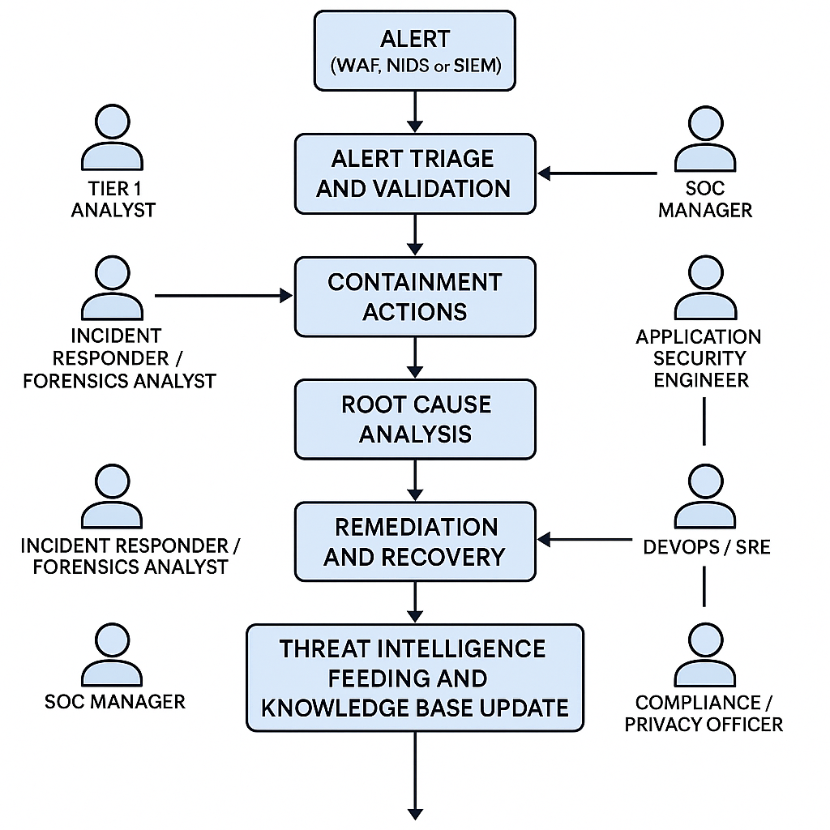
We have potential threats originating from multiple systems, each of which requires its own identity management system (potentially integrated but not so simple), its own interface and analytics, and each of which requires in depth understanding of the system in question and the specific domain being protected.

Slide 17
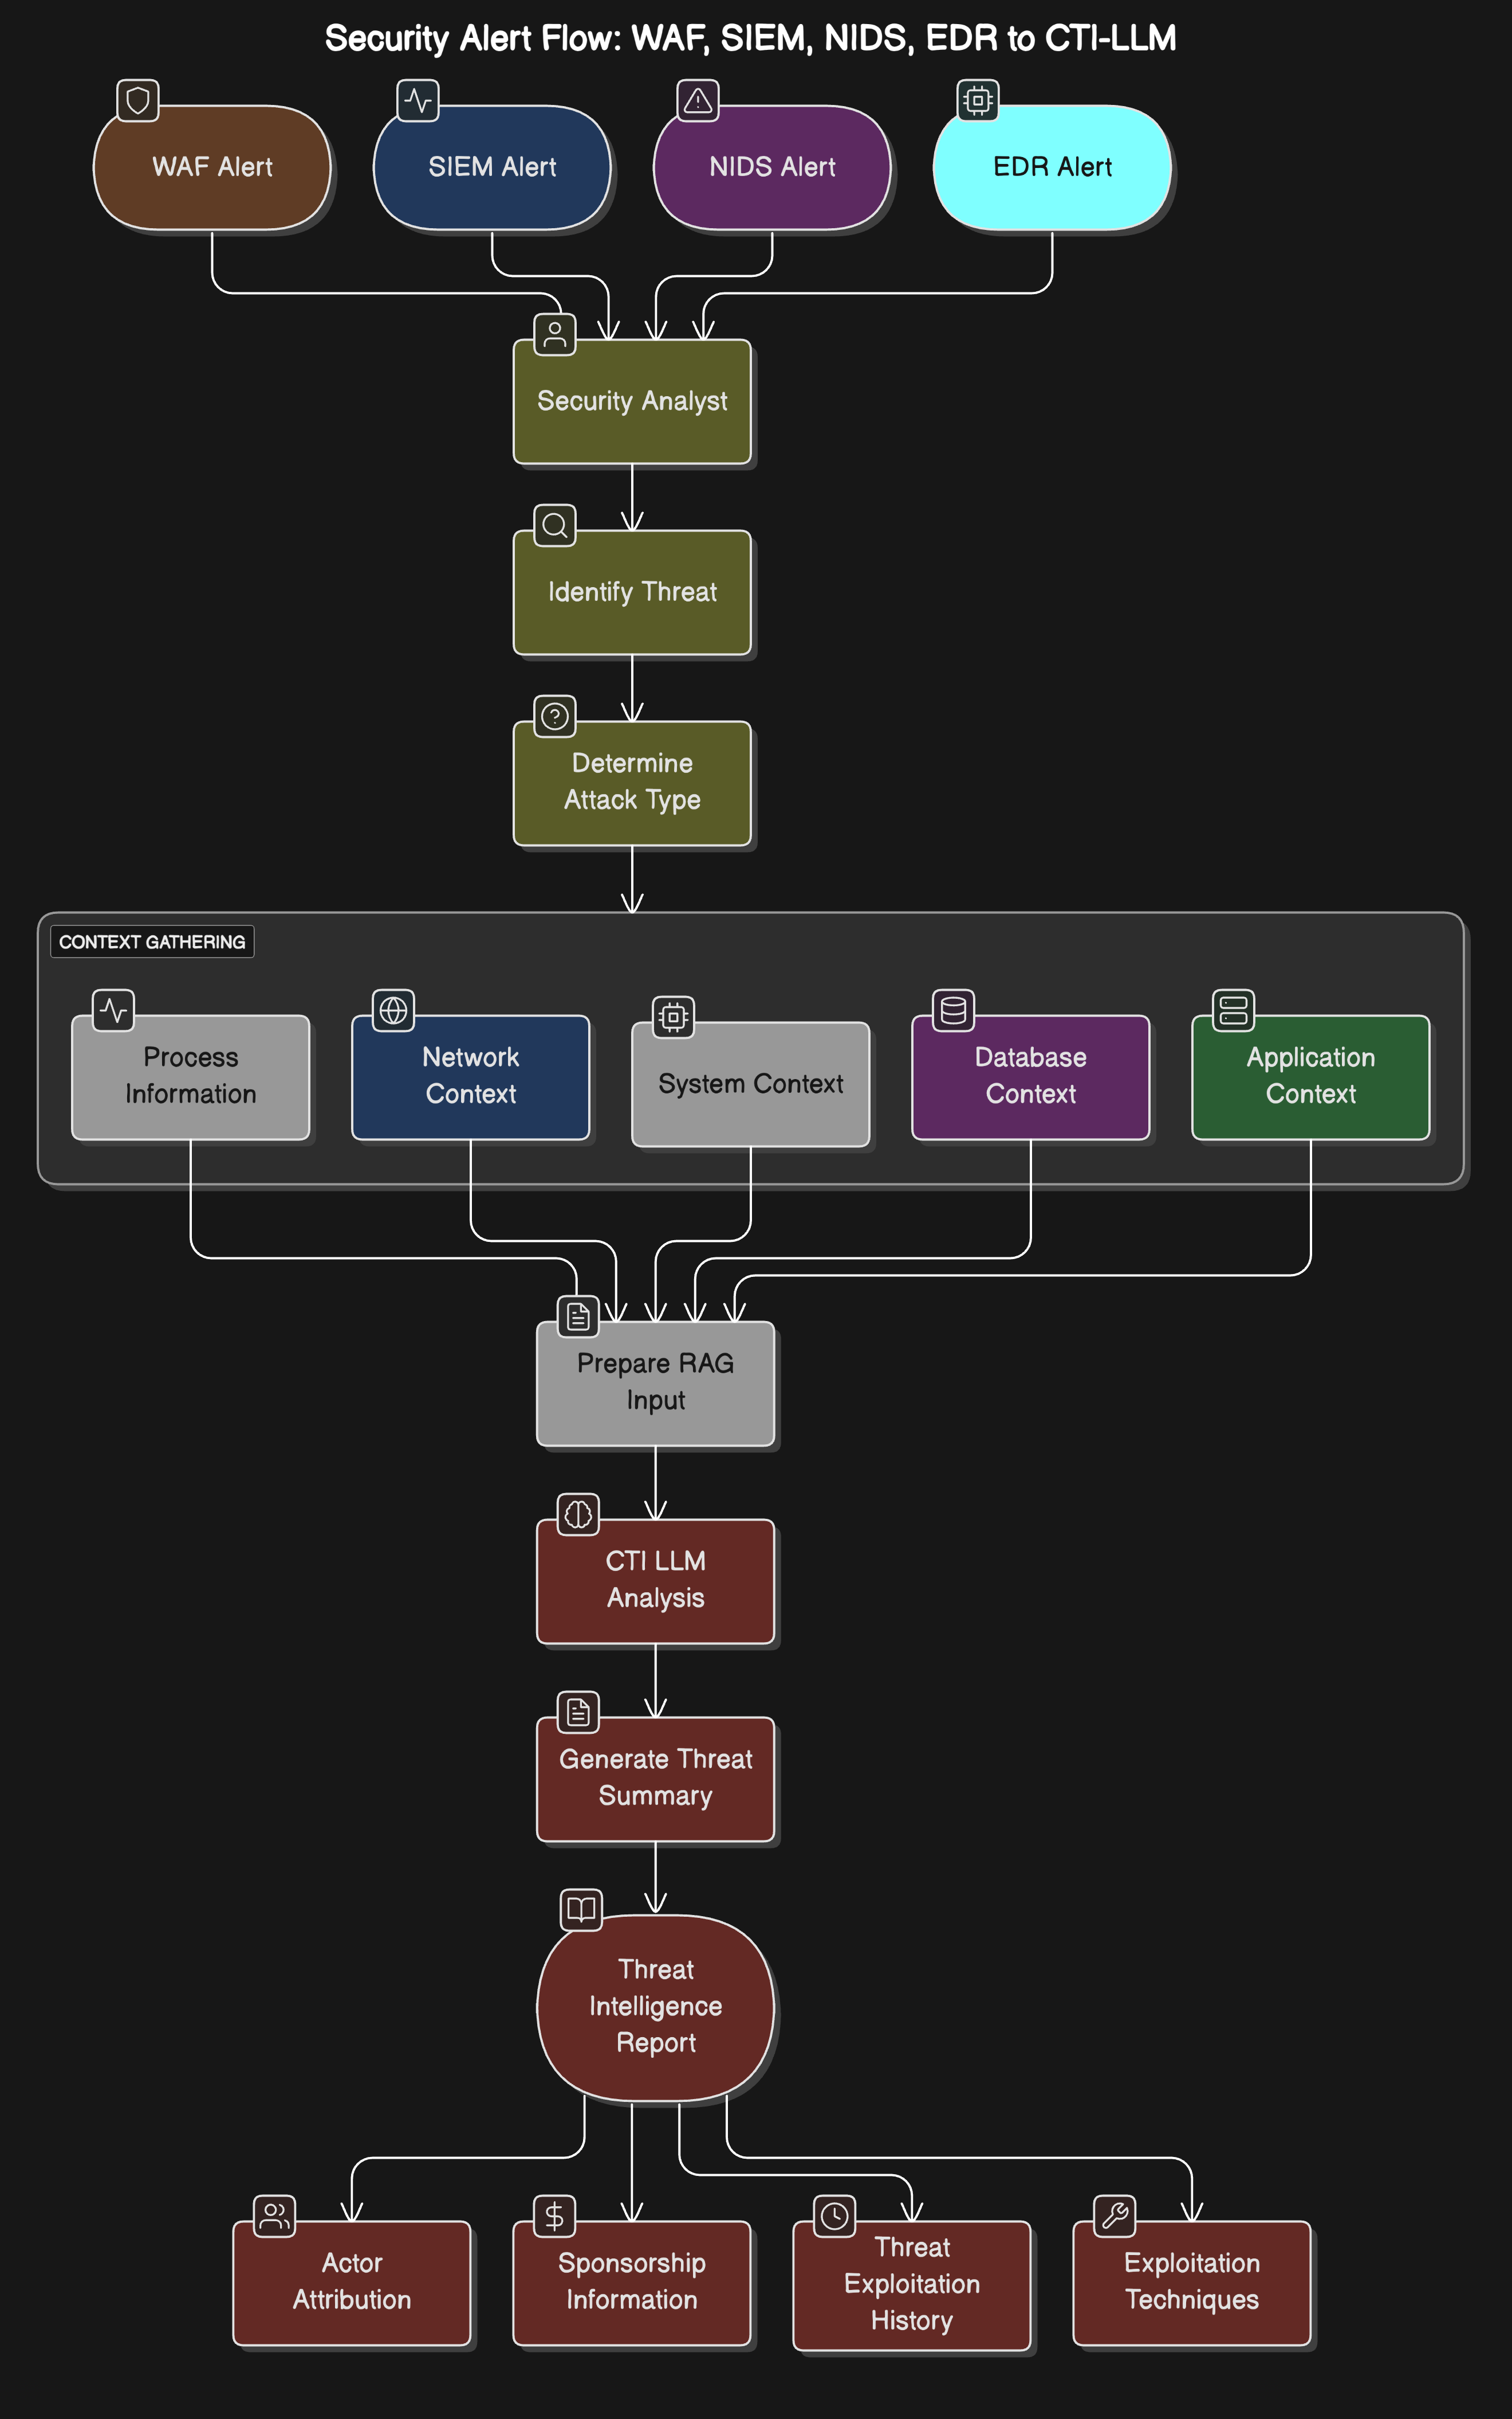
Stop the madness!
Consolidate threat sources and normalize the data. Feed into CTI-LLM that collates the detailed technical info with best-in-class industry knowledge (Ignite).
Enter Athena…

Slide 18
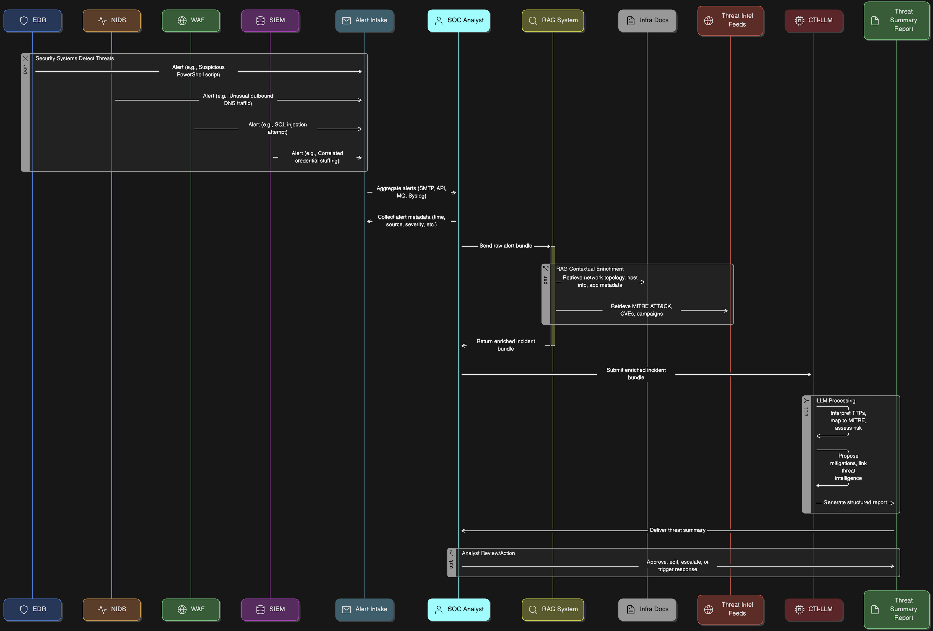
End to End Threat Intake and Response with Athena’s CTI-LLM

Slide 19
Cyber Security Language Models
Model Name | Introduced | Developer(s) | Base Model | Training Methodology | Targeted Domains
CyberPal.AI | Aug-24 | Matan Levi et al. | Not specified | Instruction tuning with SecKnowledge dataset; evaluated using SecKnowledge-Eval benchmark | Threat hunting, malware analysis, vulnerability assessment, incident response
Llama-Primus | Feb-25 | Trend Micro AI Lab | Llama-3.1-8B-Instruct | Continual pretraining on cybersecurity corpus; instruction fine-tuning with curated QA tasks | Cyber threat intelligence, vulnerability classification, security certification preparation
SecBERT | 2022 | jackaduma | BERT | Pretrained from scratch on cybersecurity texts including APTnotes, Stucco-Data, CASIE, and SemEval-2018 Task 8; custom vocabulary | Threat intelligence, NER, text classification, semantic understanding, Q&A in cybersecurity context
SecureBERT | 2022 | Ehsan Aghaei et al. (UNC Charlotte) | BERT | Continual pretraining with customized tokenizer on large corpus of cybersecurity text | Cyber threat intelligence, cyber automation, phishing detection, code and malware analysis, intrusion detection
CTI-BERT | Dec-23 | IBM T.J. Watson Research Center | BERT | Pretrained from scratch on high-quality cybersecurity corpus containing CTI reports and publications | Cyber threat intelligence extraction, security entity (IoCs) extraction, attack technique (TTPs) classification
SecurityLLM | Jan-25 | ZySec-AI | Zephyr-7b-beta | Direct Preference Optimization (DPO) training across 30+ security domains | Threat analysis, compliance verification, security architecture reviews, SOC operations, risk management
SecurityBERT | Jun-23 | Mohamed Amine Ferrag et al. | BERT | Privacy-preserving encoding technique (PPFLE) combined with Byte-level Byte-Pair Encoder (BBPE) Tokenizer; trained on IoT data | Cyber threat detection in IoT/IIoT devices
Variety of models have been introduced with a broad range of test methodologies and applications. Technology development and adoption is still in its infancy.

Slide 20
Evaluating the Performance of Cyber Security LLMs
Benchmarks for Cyber Security Language Models
Benchmark | Organization / Authors | Open Source | Cybersecurity Domain | Key Tasks | Introduced In
CTIBench | University of Waterloo & AI4Sec | Yes (GitHub, Hugging Face) | Threat Intelligence, Vulnerability Analysis, Threat Attribution | CTI-MCQ, CTI-RCM, CTI-VSP, CTI-TAA | Jul-24
SecKnowledge-Eval | CyberPal.AI (Authors of SecKnowledge Paper) | No (Contact authors) | Instruction Following, Threat Analysis, Security Reasoning | Threat/attack pattern understanding, contextual security tasks | Aug-24
CyberSecEval 2 | Meta AI | No | Offensive & Defensive Cybersecurity, LLM Risk Assessment | Malicious instruction handling, threat detection, security training evaluation | Apr-24
Sophos Benchmark Suite | Sophos AI | No | SOC Operations, Incident Handling | Incident summarization, SQL generation, severity rating | Mar-24
SECURE | Rochester Institute of Technology | Partially (some datasets) | ICS Security, Threat Reasoning | Knowledge extraction, understanding, reasoning in ICS scenarios | May-24
Cybench | CTF Community Researchers | Limited (some CTF challenges) | Offensive Security, Exploit Development | CTF task solving, vulnerability discovery, exploit execution | Jun-24
Evaluation of open-source benchmarks, applicability to threat intelligence specifically and potentially expanding and creating our own benchmark that speaks to the capabilities around Flashpoint Threat Intel specifically.

Slide 21







Base-model Selection & Training
Domain-Specific LLM
Specialized for cybersecurity analysis
Fine-Tuning Pipeline
2
Adapting to security tasks
Benchmarking Framework
Measuring security-specific performance
Safety Guardrails
Ensuring responsible AI use
Leveraging Large Language Models (LLMs) for tasks like summarizing threat intelligence, explaining alerts, or answering analyst questions requires selecting a suitable base model and fine-tuning it on domain-specific data.

Slide 22
Benchmarking Base Models
CTI-Bench Task
Zephyr-7B-beta (F1/Acc)
Llama-3-8B-Instruct (F1/Acc)
Sec-Gemini-v1 (F1/Acc)
Metric Type
IOC Extraction
0.75
0.80
0.82
F1
TTP Identification
0.68
0.72
0.75
F1
Report Summarization
0.40
0.45
0.48
ROUGE-L
Vulnerability Mapping
0.85
0.88
0.90
Accuracy
Overall Rank
3
2
1
-
Before investing in fine-tuning, evaluate candidate base models out-of-the-box on relevant benchmarks. Proposed models: Zephyr-7B-beta, Llama-3-8B-Instruct, Sec-Gemini-v1 (assuming availability).
CTI-Bench is suggested, likely containing tasks relevant to Cyber Threat Intelligence (CTI) use cases (e.g., IOC extraction, TTP identification, threat report summarization).
Based on illustrative results, Sec-Gemini-v1 shows the best OOTB performance, followed by Llama-3-8B. This quantitative data provides a strong basis for selecting the most promising base model for subsequent fine-tuning.

Slide 23

Example: CyBERT (2021)
Contextualized Embeddings for the Cybersecurity Domain
The primary contribution of this paper is providing the security community with an initial fine-tuned BERT model that can perform a variety of cybersecurity-specific downstream tasks with high accuracy and efficient use of resources.
We create a cybersecurity corpus from open-source unstructured and semi-unstructured Cyber Threat Intelligence (CTI) data and use it to fine-tune a base BERT model with Masked Language Modeling (MLM) to recognize specialized cybersecurity entities.
We evaluate the model using various downstream tasks that can benefit modern Security Operations Centers (SOCs).
The fine-tuned CyBERT model outperforms the base BERT model in the domain-specific MLM evaluation. We also provide use-cases of CyBERT application in cybersecurity based downstream tasks.
P. Ranade, A. Piplai, A. Joshi and T. Finin, "CyBERT: Contextualized Embeddings for the Cybersecurity Domain," 2021 IEEE International Conference on Big Data (Big Data), Orlando, FL, USA, 2021, pp. 3334-3342, doi: 10.1109/BigData52589.2021.9671824.

Slide 24
LLM Training Optimization Techniques
Approaches to Optimizing LLM Model Size & Compute Characteristics

Slide 25

Pretraining vs Finetuning
The general process of creating an LLM includes pretraining and finetuning. The term "pre" in "pretraining" refers to the initial phase where a model like an LLM is trained on a large, diverse dataset to develop a broad understanding of language
This pretrained model then serves as a foundational resource that can be further refined through finetuning, a process where the model is specifically trained on a narrower dataset that is more specific to particular tasks or domains.

Slide 26

PEFT: Parameter Efficient Fine Tuning
PEFT stands for Parameter Efficient Fine-tuning.
ML models are essentially complex mathematical equations with numerous coefficients or weights.
These coefficients are responsible for the model behavior and make it capable of learning from data.
During training of ML models, we adjust these coefficients to minimize errors and make accurate predictions.
In case of LLMs, which can have billions of parameters, and changing all of them during training can be computationally expensive and memory-intensive.
PEFT, as a subset of fine-tuning, takes the parameter efficiency seriously.
Instead of altering all the coefficients of the model, PEFT selects a subset of them.
It helps us significantly reducing the computational and memory requirements.

Slide 27


Slide 28


LoRA and QLoRA for Coefficient Selection
LoRA (Low-Rank Adoption):
  It is a technique exploits the fact that some weights have more significant impacts than others. In LoRA, the large weight matrix is divided into two smaller matrices by factorization.
  We reduce the number of coefficients that need adjustment, making the fine-tuning process more efficient.
QLoRA (Quantization + Low-Rank Adoption):
  Quantization involves converting high-precision floating-point coefficients into lower-precision representations, such as 4-bit integers.
  Quantization offers a solution by reducing the precision of these coefficients.
  For instance, a 32-bit floating-point number can be represented as a 4-bit integer within a specific range. This conversion significantly shrinks the memory footprint.

Slide 29

Instruction Tuning
Finetuned Language Net (FLAN)
Whereas supervised fine-tuning trains models on input examples and their corresponding outputs, instruction tuning augments input-output examples with instructions, which enables instruction-tuned models to generalize more easily to new tasks.
"Instruction tuning", which finetunes language models on a collection of tasks described via instructions, substantially boosts zero-shot performance on unseen tasks.
Methods differ based on how the instruction tuning data is constructed.
Finetuned Language Models Are Zero-Shot Learners; Wei et al. 2022

Slide 30

Prompt Tuning
https://www.leewayhertz.com/parameter-efficient-fine-tuning/

Slide 31

Tuning Approaches

Slide 32
Different Training Strategies
Aspect | Traditional Fine-Tuning | Instruction Tuning | Hybrid Approach
Description | Adapting a general-purpose model to cybersecurity by updating weights on a large unlabeled/labeled domain corpus | Adapting a model to follow explicit instructions in natural language format across various cybersecurity tasks | Combines traditional fine-tuning on a domain corpus followed by instruction tuning or integrates both into a single multi-objective training setup
Input Format | Raw cybersecurity texts (blogs, CVEs, advisories) | Tuples like (“Map this CVE to MITRE ATT&CK”, CVE text → expected answer) | First: domain texts → corpus adaptation; then: curated instructions → multi-task generalization
Training Objective | Masked Language Modeling (MLM) or Causal Language Modeling (CLM); optionally with classification/regression heads | Supervised generation / classification using cross-entropy loss | Pretrain or adapt with MLM, then instruction tune; or mix the objectives (e.g., multi-task loss)
Best For | Embedding learning, classification, entity recognition, internalizing domain-specific syntax and jargon | Multi-turn reasoning, question-answering, structured task execution (e.g., IOC extraction, root cause summarization) | Use cases needing both strong domain understanding and complex task following (e.g., SOC assistant, security triage)
Sample Cyber LLMs | • CTI-BERT (IBM) • SecureBERT (UNC) • SecBERT (jackaduma) • SecurityBERT (IoT) | • CyberPal.AI • Llama-Primus • SecurityLLM • Sec-Gemini v1 (RAG + instruction) | • Llama-Primus (base → merged) • CTI-BERT + instruction adapters • CyberPal.AI w/ SecKnowledge → SecKnowledge-Eval loop
Strengths | ✔ Captures nuanced cybersecurity terminology ✔ Improves base model for domain-specific NLP tasks | ✔ Generalizes across task types ✔ Interpretable and human-aligned ✔ Easier downstream zero-shot/few-shot use | ✔ High performance in both static understanding and reasoning ✔ Flexibility across tasks ✔ Lower label dependency if pretrained well
Weaknesses | ✖ May not generalize well to unfamiliar task formats ✖ Doesn’t teach “task framing” | ✖ Requires high-quality curated instruction data ✖ May hallucinate if not grounded | ✖ Expensive and complex training pipeline ✖ Risk of forgetting if improperly scheduled
Compute Requirements | • Requires moderate GPU resources for continual pretraining (e.g., 8x A100 for 100M tokens) • Good fit for distributed training | • Typically less data but more curated, though larger sequence lengths and decoder-based models (e.g., LLaMA, GPT) may demand more memory • 8x A100 for ~20K examples | • Highest resource requirement: pretraining on corpus (TPU/8x A100) + instruction finetuning (decoder model, RAG-enabled, ~24GB GPU RAM or more)
Parameter Efficient Tuning | Supported via LoRA, Adapters (sparse updates) | Works well with PEFT (e.g., QLoRA, LoRA), especially for instruction-tuning-friendly architectures | Common hybrid practice: LoRA for instruction head + frozen backbone or adapter fusion
Instruction-Awareness | ❌ Model is unaware of instructions explicitly | ✅ Instruction-following enabled | ✅ Instruction-aware + domain-knowledge enriched
Fine-Tuning Duration | Long (10–40 hours for 100M tokens depending on model size) | Medium (4–12 hours for 20K–100K examples depending on format) | Longest (20–80 hours if running pretrain + instruction + eval loop with RAG)

Slide 33

Adapting LLMs for Cyber Security
Hybrid approaches are proving to be the most effective and involve a combination of traditional finetuning strategies along with the instruction based tuning and RLHF. Source: https://gradientflow.com/maximizing-the-potential-of-large-language-models/

Slide 34
Instruction Dataset
Manual Creation
Weak Supervision
Synthetic Self-Play
Human experts (SOC analysts, CTI analysts) write high-quality prompts and responses. Slow and expensive but yields the best quality.
Use heuristics, templates, or existing structured data (e.g., alert fields + analyst notes) to automatically generate instruction pairs. Faster but lower quality, requires careful filtering.
Use a powerful LLM (e.g., GPT-4) to generate instruction prompts and corresponding responses based on provided documents or guidelines. Can scale effectively but requires careful validation to ensure quality and avoid reinforcing biases.
Supervised fine-tuning (SFT) requires an instruction dataset: pairs of (prompt, desired_response) demonstrating how the model should behave for specific tasks. Estimates range from 20k to 100k high-quality instruction examples. Quality often matters more than quantity.
A combination of methods is often practical: start with a smaller set of high-quality, manually created examples covering core use cases, then augment with carefully validated synthetic data or weakly supervised examples to increase diversity and scale.
The focus should be on creating instructions that reflect the target tasks (e.g., summarizing an alert with environmental context, explaining an ATT&CK technique, correlating IOCs).

Slide 35
PEFT Configuration
LoRA (Low-Rank Adaptation)
QLoRA
Injects small, trainable low-rank matrices into the model's layers. Only these small matrices are updated, drastically reducing the number of trainable parameters.
Combines LoRA with quantization (e.g., 4-bit NormalFloat) to further reduce memory footprint during training, allowing fine-tuning of larger models on less hardware.
The rank parameter (r) controls the size (rank) of the LoRA matrices. Common values are 8, 16, 32, 64. Higher ranks allow capturing more complex adaptations but increase trainable parameters and memory.
Fine-tuning typically involves applying LoRA/QLoRA to specific layers (often attention layers) with a chosen rank and alpha parameter (scaling factor).
Parameter-Efficient Fine-Tuning (PEFT) methods allow adapting large models with significantly less computational cost than full fine-tuning.
Using QLoRA with a moderate rank (e.g., 16) is a common and effective strategy for balancing adaptation quality with resource efficiency when fine-tuning models in the 7B-13B parameter range. Experimentation is needed to find the optimal rank and layers to target.

Slide 36
Threat Intelligence Data Integration
Integrating Flashpoint Ignite & Other Data Sources into Custom Trained LLM

Slide 37
Cyber Security Use Cases leveraging Flashpoint Ignite
Actionable Threat Intelligence
  Real-time alerts on emerging cyber threats
  Indicators of Compromise (IOCs) and threat actor intelligence
  Curated insights into darknet and deep web activities
Risk Management and Vulnerability Assessment
  Detailed vulnerability information, CVE analysis, exploit availability
  Predictive insights to prioritize patching and security remediation
Cybercrime Monitoring
  Monitoring dark web forums, marketplaces, and illicit communities
  Early detection of credential leaks, fraudulent activities, and malicious campaigns
Integrations and API
  Seamless integrations with existing security stacks (SIEM, SOAR, endpoint security solutions)
  Rich API for threat feeds and automation workflows
Malware & Threat Actor Profiling
  Detailed threat actor reports, attribution, and behavior analysis
  Insights into geopolitical threats, hacktivism, organized crime, and nation-state actors
  Latest Malware exploits & Attack Vectors
Real-Time Threat Intelligence Analysis & Summarization
Automatically generate concise summaries of new threats and intelligence reports.
Reduces analyst time spent reviewing large threat intel documents.
Automated Incident Triage & Root Cause Analysis
Objective: Leverage the LLM to swiftly analyze incidents by correlating alerts with known vulnerabilities, threat actors, and recent intelligence.
Benefit: Accelerates response time and provides immediate contextual understanding.
Proactive Vulnerability & Exploit Prioritization
Objective: Analyze CVEs, exploit availability, and real-world threat activity to prioritize patches and responses.
Benefit: Improves security posture by aligning efforts with real-world risk.
Threat Actor Attribution & Behavioral Analysis
Objective: Generate threat actor profiles from detailed data, recognizing patterns, tools, and tactics.
Benefit: Enhances attribution accuracy and threat prediction capabilities.
Expected Benefits
Accelerate security operations by significantly reducing the time-to-analysis for threat intelligence.
Enhance analytical accuracy through real-time integration with evolving threat data.
Improve cybersecurity decision-making, prioritization, and proactive response.

Slide 38




Corpus Sizing
Flashpoint Data
Open Datasets
Sizing Target
Quality vs. Quantity
Rich, real-world threat actor communications and CTI. Volume can be significant but requires careful filtering, sanitization, and adherence to licensing and compliance constraints.
Public CTI feeds (e.g., MISP galaxies, AlienVault OTX), security blogs, academic papers, vulnerability databases (NVD), malware analysis reports (VirusTotal, sandbox reports), sanitized security logs.
The total corpus size should ideally be in the billions of tokens to effectively adapt the LLM. A corpus of 10B+ tokens would be a strong target.
Quality and relevance are as important as quantity. Focus on high-quality, domain-specific content.
Fine-tuning requires a substantial corpus of relevant text data. The proposal includes Flashpoint data (dark web, illicit communities - requires careful handling) and open datasets.
Quantifying the available tokens from Flashpoint (post-processing) and selected open datasets is necessary to determine if sufficient data exists or if further data sourcing is required.

Slide 39

Finetuning And Integration Strategy
Given Ignite’s data-rich and specialized threat-intel environment, the ideal fine-tuning approach is a Hybrid Fine-Tuning + Instruction Tuning strategy.
Step 1: Domain Corpus Preparation
Data Sources; Flashpoint Ignite threat intelligence feeds (dark web forums, CVEs, threat actor reports, incident summaries). Structured indicators (IOC, TTPs, MITRE ATT&CK mappings).
Fine-Tuning Objective: Masked Language Modeling (MLM) to internalize threat intelligence vocabulary and cybersecurity-specific context.
Step 2: Curated Instruction Dataset Creation
Instructions Examples:
"Summarize this threat report.”
"Attribute this incident to a known threat actor.”
"Identify potential impacts of this CVE.”
"Extract all relevant IOCs from this threat document."
Format: Structured as (Instruction, Input → Desired Output) tuples.
Step 3: Instruction Tuning
Objective: Enable the LLM to follow security-specific instructions.
Methodology: Supervised fine-tuning with instruction tuples, cross-entropy loss on generated outputs.
Step 4: Integration of Retrieval-Augmented Generation (RAG)
Combine the LLM with Ignite’s real-time data retrieval via embeddings and vector stores.
Provide the model with external real-time context (latest threats, CVEs, etc.) to answer queries more accurately.

Slide 40
LLM Model& Context Integration & Compute Requirements
Leverage state of the art Cyber Security LLMs and finetune against Flashpoint data using optimized finetuning strategies
Leverage state of the art Cyber Security LLMs with robust instruction-following capabilities and retrieval augmentation compatibility:
Llama-Primus or Sec-Gemini v1 (instruction-tuned, cybersecurity-focused), or
Alternative: Zephyr-7b-beta for efficiency.
PEFT: Utilize LoRA (Low-Rank Adaptation) or adapters for efficient updates and rapid deployment.
RAG Integration (Inference & Retrieval):
Utilize vector stores (e.g., Neo-4j) for embedding-based real-time retrieval of environment context. (Minimal additional GPU overhead, primarily inference-focused.)
Compute Requirements (roughly)
Continual Pretraining (MLM):
Moderate-to-large GPU resources (e.g., 8x NVIDIA A100 GPUs).
Expected training duration: ~10–40 hours depending on corpus size (50M–200M tokens).
Instruction Tuning:
4–12 hours on 8x NVIDIA A100 GPUs for datasets of 20K–100K instruction tuples.

Slide 41
Compute Budget Considerations (CONT)
$2-3
100s
A100 GPU Cost
Training Hours
Per hour on cloud
For full fine-tuning runs
4-8
50-70%
Recommended GPUs
Potential Savings
A100s/H100s for efficient training
Using spot instances
Fine-tuning LLMs, even with PEFT, requires significant GPU resources. Hardware options include on-premise GPUs (NVIDIA A100s or similar), cloud rented GPUs (NVIDIA H100s, A100s), or specialized Cloud TPUs/Trainium.
Using cloud spot instances can significantly reduce cost but requires implementing robust checkpointing and restart strategies to handle potential interruptions.
For an 8B parameter model with QLoRA and a ~100k instruction dataset, fine-tuning might take several hours to days on a multi-GPU setup. The budget must accommodate initial fine-tuning, hyper-parameter search, and ongoing weekly updates.

Slide 42




Sensitive Data Handling (Flashpoint, OFAC/ITAR)
Compliance
Access Control
Encryption
Be aware of potential OFAC (Office of Foreign Assets Control) or ITAR (International Traffic in Arms Regulations) implications if data involves sanctioned entities or export-controlled information. Consult legal counsel to ensure compliance based on data specifics and user locations.
Implement strict, granular access controls (potentially leveraging graph DB labels or separate databases) to ensure only authorized personnel can access raw Flashpoint data or derivatives.
Encrypt sensitive data both at rest (storage) and in transit. Consider application-level encryption for particularly sensitive fields.
Minimization
Sanitization/Anonymization
Process and store only the minimum data necessary for the intended analysis. Avoid broad collection if possible.
Implement procedures to sanitize or anonymize data before it's used for broader analysis or LLM training, where feasible and appropriate.
Ingesting sensitive third-party data like Flashpoint (dark web intelligence) requires careful handling due to content sensitivity and potential compliance obligations.
Handling data like Flashpoint requires robust technical controls and strict adherence to legal and contractual obligations.

Slide 43
LLM Product Lifecycle
Methodology: Build, Evaluate, Test, Deploy, Iterate

Slide 44






Data Ingestion Architecture Analysis
Reliable Data Foundation
The foundation for effective security analysis
Normalized Processing
Consistent handling of diverse data streams
Scalable Architecture
Designed to handle high volumes at enterprise scale
The foundation of an effective environmental-context aware cybersecurity platform lies in its ability to reliably ingest, normalize, and process diverse data streams at scale. This section evaluates key architectural choices for the data ingestion pipeline.

Slide 45

Finetuning strategy to be aligned with optimal compute requirements

Slide 46


Slide 47



Benchmark & KPI Framework
Technical Benchmarks
Model capability assessment
Operational KPIs
Real-world performance metrics
Continuous Evaluation
Ongoing performance tracking
A robust framework for benchmarking model performance and measuring Key Performance Indicators (KPIs) is essential to evaluate success, guide improvements, and demonstrate value.

Slide 48
Mapping CTI-Bench Tasks to Use Cases
Use Cases
CTI-Bench Tasks
Summarize incoming threat reports
Report Summarization (ROUGE score)
Extract IOCs from alerts/reports
IOC Extraction (F1 score)
Identify ATT&CK techniques used
TTP Identification (F1/Accuracy)
Answer analyst questions about threats
Question Answering (Accuracy/F1)
The chosen benchmark suite (e.g., CTI-Bench) should contain tasks that directly map to the intended use cases of the LLM within the platform.
Define "good enough" performance thresholds (e.g., F1 > 0.80 for IOC Extraction, Accuracy > 0.75 for TTP Identification) based on operational requirements and baseline performance. These thresholds determine if a model version is suitable for deployment.
Ensure the benchmark covers the critical capabilities expected from the LLM in production. If existing benchmarks lack coverage for specific use cases, custom evaluation tasks may need to be developed.

Slide 49
Simulating Environment-Grounded Questions
Evaluate Answer Quality
Build Benchmark Harness
Assess answer correctness, completeness, and faithfulness to the source data (checking for hallucination).
Develop Grounded QA Dataset
Create Representative Data Snapshot
Develop a testing framework that provides the LLM access to the relevant data snapshot when answering these questions.
Create question-answer pairs where the answer requires retrieving and synthesizing information from the data snapshot (e.g., "What user accounts logged into server 'X' during the time of alert 'Y'?").
Prepare a realistic sample of environmental data (logs, assets, alerts) that represents the production environment.
Standard benchmarks often test generic knowledge. The platform aims to answer questions grounded in the specific ingested environmental context (logs, assets, alerts).
This requires significant effort but is crucial for evaluating the core RAG capability of the system – its ability to reason over specific environmental context.

Slide 50

Project Lifecycle

Slide 51

Safety, Compliance, Red-Team
Robust Defenses
1
Protection against misuse
Regulatory Compliance
Adherence to legal requirements
Adversarial Testing
3
Proactive security validation
Ensuring the platform operates safely, securely, and in compliance with regulations is paramount, especially when dealing with sensitive data and powerful LLMs.

Slide 52
Prompt Injection Defenses
Input Filtering/Sanitization
Instruction Fine-tuning
Output Filtering
Attempt to detect and remove malicious instructions from user input (difficult to make foolproof).
Train the model on examples where it should refuse harmful or out-of-scope requests.
Scan the LLM's generated response for harmful content, policy violations, or indicators of successful injection before showing it to the user.
Prompt Engineering
Input Classification
Structure prompts carefully to clearly delineate user input from system instructions (e.g., using delimiters, XML tags).
Employ a smaller, fine-tuned model to classify user input intention before passing it to the main LLM.
LLMs are vulnerable to prompt injection, where malicious user input tricks the model into ignoring its instructions or performing unintended actions.
Recommendation: Employ a multi-layered approach. Combine robust prompt engineering, instruction fine-tuning for refusal on common attacks, and output filtering as a final safety net. Relying on input filtering alone is generally insufficient.
Ongoing monitoring and red-teaming are needed to discover new injection vectors.

Slide 53




Audit Logging
Comprehensive Logging
Secure Storage
Log every user prompt and the corresponding LLM response. Include metadata such as user ID, timestamp, session ID, model version used, data sources consulted (retrieval context), and any safety flags triggered.
Store audit logs securely in a dedicated, immutable logging system (e.g., write-once storage, dedicated security logging platform).
Retention Policy
Access Control
Retain audit logs according to relevant compliance requirements and internal security policies (often longer than operational data retention).
Implement strict access control on audit logs, limiting access to authorized security and audit personnel.
Comprehensive audit logging is essential for security monitoring, forensic review, and compliance.
Ensure the logging mechanism captures sufficient detail to reconstruct interactions and investigate potential misuse or security incidents.

Slide 54
Data Retention Policy
Cold Storage (Remainder of retention period)
Warm Storage (Up to 1 year)
Hot Storage (30-90 days)
Cheaper disk or cloud storage (e.g., S3 Standard) for less frequent access. Supports extended investigations and compliance requirements.
Archival storage (e.g., S3 Glacier Deep Archive, Azure Archive Storage) for long-term compliance. Minimal access expected.
Active analytics database for immediate query access. Supports real-time analysis and recent investigations.
Defining data retention periods is crucial for compliance, operational needs, and cost management. Policies must differentiate between raw and processed data.
Implementing tiered storage aligned with retention policies is essential for cost optimization. TTL (Time-To-Live) mechanisms within databases can automate the deletion of data from active tiers, while separate archival processes handle moving data to cold storage.
The data retention policy requires formal sign-off from stakeholders, typically including the CISO, Legal/Compliance department, and potentially a Data Governance Committee.

Slide 55

MLOps / Deployment
CI/CD Pipeline
1
Automated build, test, deploy
Model Registry
2
Version tracking and management
Serving Infrastructure
Scalable inference deployment
Monitoring & Feedback
4
Performance tracking and improvement
Efficiently developing, deploying, and managing the ML models and the overall platform requires robust MLOps practices and a well-defined deployment strategy.

Slide 56
Serving Path Comparison
Triton Inference Server (NVIDIA)
vLLM
Ollama
Custom FastAPI/Flask + Transformers
An open-source library specifically designed for fast LLM inference and serving. Uses techniques like PagedAttention to optimize memory usage and throughput for LLMs. Gaining popularity for its performance.
Focuses on ease of use for running LLMs locally or deploying them simply. May lack some advanced performance optimization or production features compared to Triton or vLLM.
High-performance inference server supporting multiple frameworks (TensorFlow, PyTorch, TensorRT) and backends. Offers features like dynamic batching, model ensembling, and GPU optimization. Can be complex to configure.
Building a custom serving layer using web frameworks and libraries like Hugging Face Transformers. Offers maximum flexibility but requires implementing features like batching, queuing, and scaling manually.
Serving the fine-tuned LLM efficiently and reliably requires a dedicated inference serving platform.
Recommendation: For high-throughput, low-latency LLM serving, vLLM is a strong contender due to its specific optimizations for LLMs. Triton is a more general-purpose, mature option suitable if serving diverse model types is required.
Evaluate based on performance benchmarks with the chosen fine-tuned model and GPU hardware. Consider if GPU multi-tenant isolation is needed if multiple models or tenants share GPUs, which Triton might handle more robustly.

Slide 57
Rollout Policy and Rollback
Blue-Green Deployment
Canary Rollout
Rollback Trigger
Maintain two identical production environments (Blue and Green). Deploy the new version to the inactive environment (Green), test it, then switch traffic.
Gradually route a small percentage of traffic to the new version. Monitor performance and error rates. Increase traffic progressively if stable.
Define automated triggers for rollback based on key metrics: increase in error rate, latency spike, drop in benchmark performance (from real-time evaluation or shadow deployment), critical safety/alignment failures.
Allows detecting issues with minimal user impact. More complex traffic routing logic required.
Allows instant rollback by switching traffic back to Blue. Requires double the infrastructure resources.
Deploying new model versions into production requires a safe rollout strategy.
Recommendation: Canary rollouts are generally preferred for ML models, as they allow gradual exposure and monitoring of subtle performance changes or unexpected behaviors with real traffic.
Combine with automated monitoring and clear rollback triggers based on critical KPIs (latency, error rate, core task accuracy).

Slide 58
Summary Value Proposition
Industry Fragmentation yields opportunity with Integrated Approach
Consolidated and normalized threat identification across the entire network infrastructure (Firewall, WAF, SIEM, NIDS, EDR)
Build and train CTI-LLM using state of the art threat intelligence (Flashpoint’s Ignite)
RAG based integration into CTI-LLM for automated contextualized responses
Yield better outcomes both in terms of threat detection and response, a necessary condition for Cyber Defense in the age of AI

Slide 59

Athena Software Group
Best in Class, AI Enabled, security solutions for Enterprise application providers.

